Slide 1
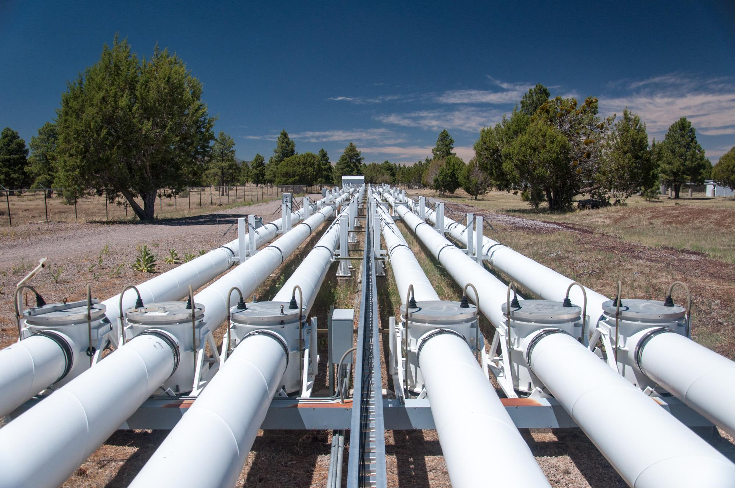



Navy Precision Optical Interferometer Data Pipeline & Reduction
Peter Kurtz (NAU)
Stephen Williams (USNO)
Notes:
Title Slide
Intro the site
Data ---> Talk about how software is used at the site
Analysis ---> Talk about the issues that current software faces / what updates/changes want to be made
Conclusion

Slide 2
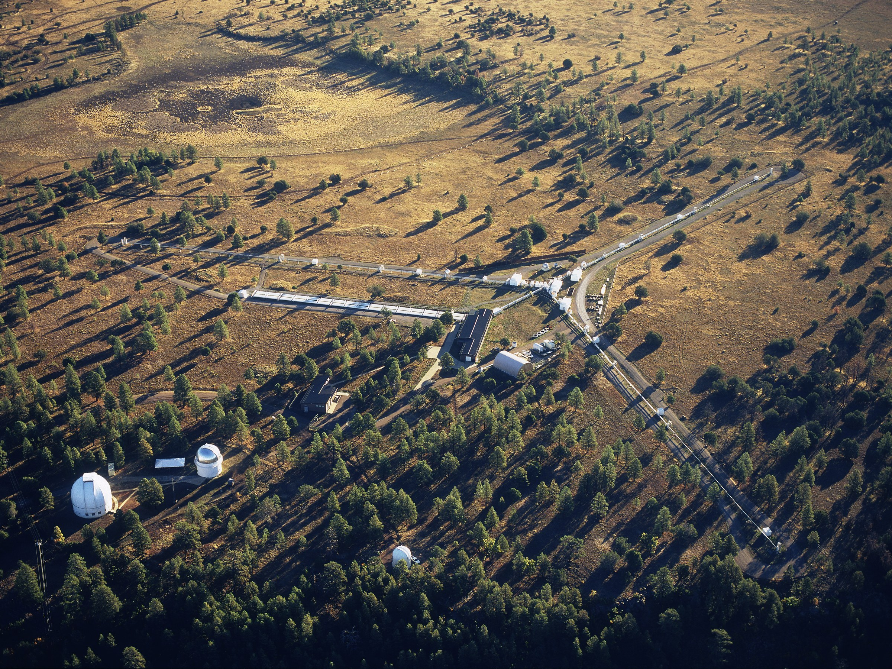
Navy Precision Optical Interferometer (NPOI)
Navy Precision Optical Interferometer (NPOI)
Navy Precision Optical Interferometer (NPOI)
Notes:
This is the the Navy Precision Optical Interferometer or NPOI for short. This site is located about 15 miles southeast of Flagstaff.
This site is owned and operated by three different entities, the United States Naval Observatory, the Navy Research Laboratory and Lowell Observatory.
The main part of the site it the three “arms” that all connect at a center point in the middle of the site. These arms are vacuum pipes that have multiple stations attached to them.
These stations house siderostats, large flat mirrors, that reflect light from a star or an object in the sky down the vacuum tubes to a central processing building.

Slide 3
Navy Precision Optical Interferometer (NPOI)
Possible locations for mirror stations
Notes:
The red circles define locations where these siderostat stations can be located. When observing, several of these stations, right now 3 but plans are to increase that up to 6,
Act in tandem to replicate a larger mirror with the diameter of the distance between the mirrors. If the three stations on the end of each arm were to be used, they could act
Like a mirror that had a radius of 250 meters, all achieved with small mirrors that are only a few feet in diameter.
Now we will zoom in on the station with the large red arrow pointing at it.

Slide 4
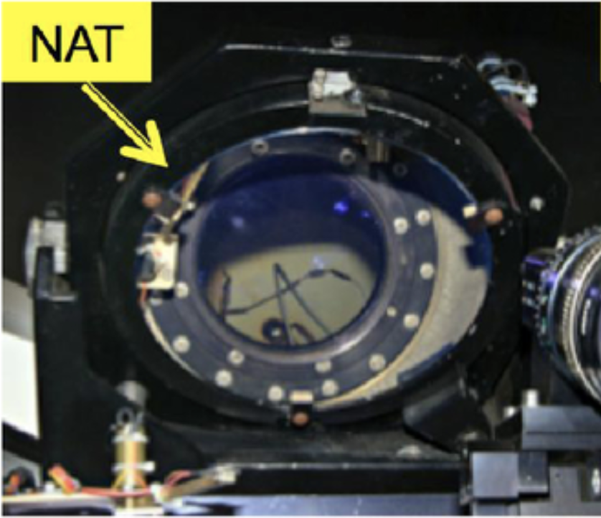
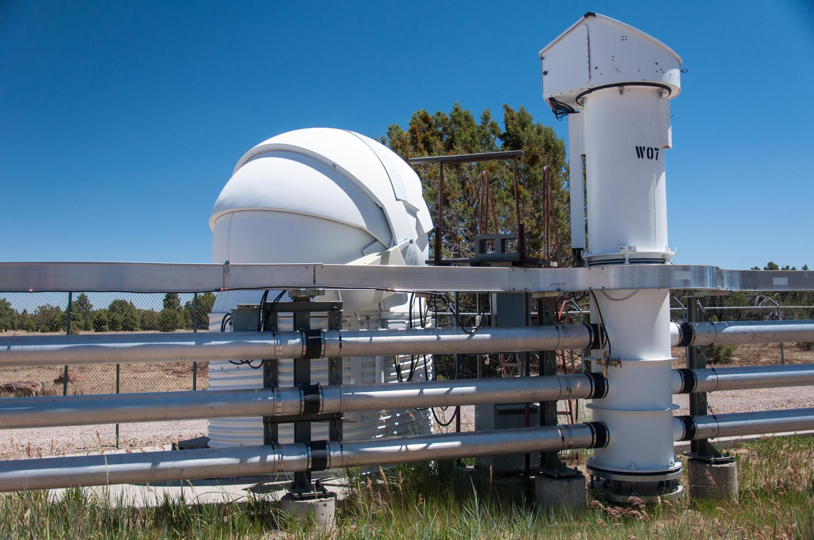
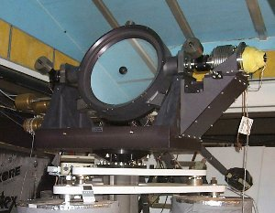
Mirror Systems
NAT (Narrow Angle Tracker)
Light path
Siderostat
Notes:
This is an up close look at one of the siderostat stations, each station consists of a “dome” and a “lizard head”, the dome holds a siderostat and some computers, whilst the lizard-head a Narrow angle tracker or NAT for short, which
Is a small mirror that is used to accurately send light down the vacuum tubes. The green arrow is the light path, the light from an object in the sky is reflected off the siderostat mirror onto the NAT
And then down the tubes.
Since three of these stations are working in tandem, the light from each of the stations are combined in a lab in the center of the site near where the arms of the array come to a point.

Slide 5
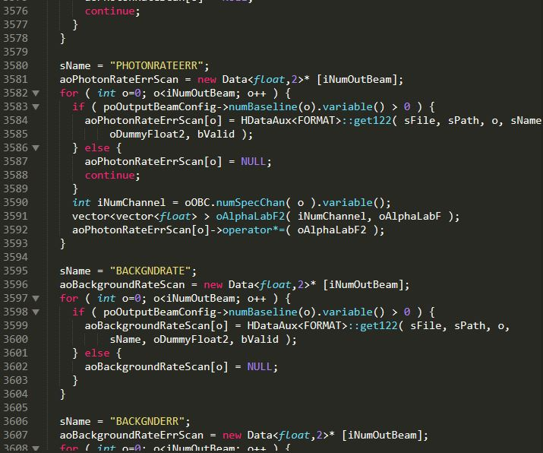
Software
Software plays large part of site
  Data Processing
  Observing
  Control

Slide 6
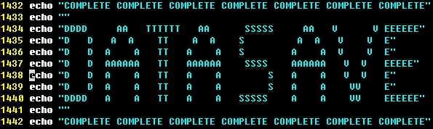
dataSave
Executed at end of night
Moves and compresses data
  5 gigabytes of data(compressed)
Notes:
An HD movie is about 5gb

Slide 7
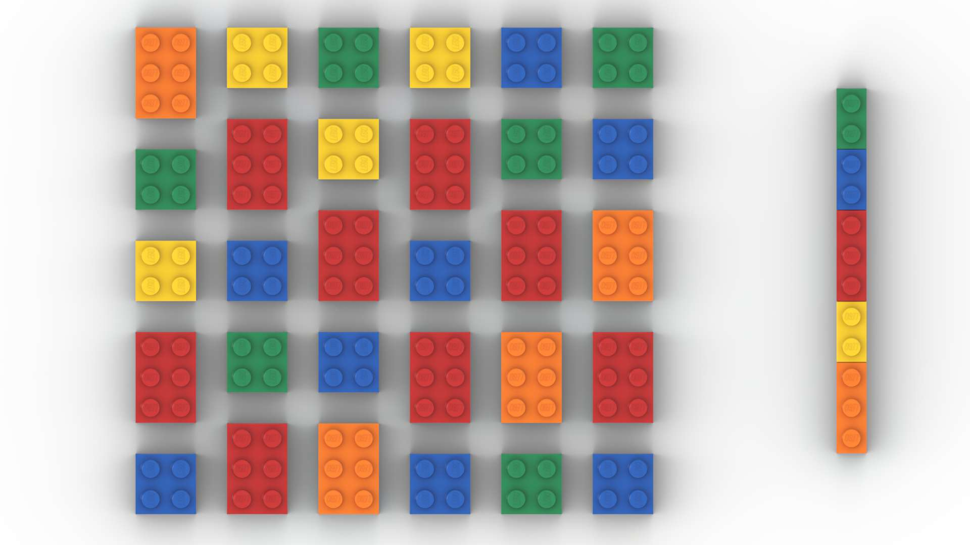
Data Reduction
Constrictor
Boa
  Add-on to Constrictor
Notes:
An HD movie is about 5gb

Slide 8
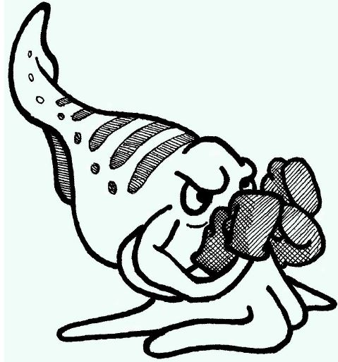
Pipelines
Oyster
  Generic Data Pipeline
Cuttlefish
  NPOI Specific Data Pipeline
Notes:
An HD movie is about 5gb

Slide 9
Ideal data operations at NPOI
  Different data levels(L0, L1, L2, L3)
Most data reduction done at NPOI
  Allow access to the public
Notes:
An HD movie is about 5gb

Slide 10
Problem
Software is outdated
  Deprecated
  Poorly designed
  Little documentation
Researchers cannot get data from the site
  Partly due to software
  Partly due to unrelated mechanical issues
Notes:
An HD movie is about 5gb

Slide 11
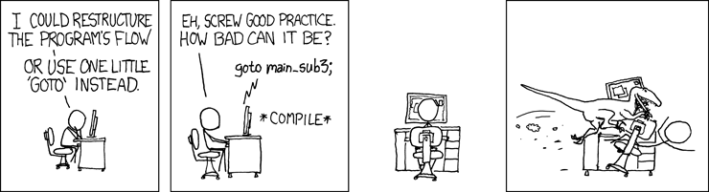
dataSave Problems
csh (C Shell)
Frankensteined
20% is commented out code
Notes:
An HD movie is about 5gb

Slide 12

Data Reduction Problems
Constrictor missing for several years
Supposed to cleanse raw data
  Remove noise
  Remove redundancies
Notes:
An HD movie is about 5gb

Slide 13
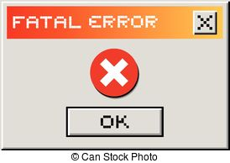
Pipeline Problems
Oyster
  General pipeline for different sites
  Developed in Germany
Cuttlefish
  Cannot compile
  Overly complicated
Notes:
An HD movie is about 5gb

Slide 14
Future
Rewrite dataSave in Python
  Modular
  Extensible
Search for Constrictor
Fix Cuttlefish
  Rewrite or fix current software
Notes:
An HD movie is about 5gb

Slide 15
Conclusion
Software play large role in NPOI
Old/Outdated software
Useful data cannot be generated until software is fixed

Slide 16

Acknowledgements

